Slide 1
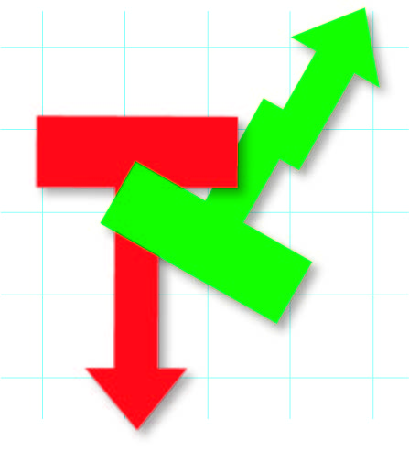
Time Trade
Developed by The Time Trade Team:
Di Leva Ignacio, Erlich Martín, Pomzstein Brandon, Shih Federico

Slide 2
Assignments and responsibilities
Martín Erlich
Database and API Management.
Ignacio Di Leva
UX, UI Development, Context Management, Server Connections
Federico Shih
Trading Functionality and Portfolio
Brandon Pomzstein
Graphic Design and Visual Assets

Slide 3
Stocks and Trading
Every day's trading session on the major stock markets starts at 9:30 a.m, lasting until 4 p.m.
2,038,953,473 trades take place in Nasdaq daily, in average, amounting to $100,124,334,359.
Total world derivatives market has been estimated at about $791 trillion.
Notes:
El Mercado de Valores suele abrir a las 9:30 am, finalmente cerrando a las 4 pm. En este tiempo, son intercambiadas millones de acciones, contratos y futuros, alcanzando más de 2 mil millones de operaciones diarias. No es sorpresa que éste mercado sea el más ocupado y active de mundo, ni que el valor estimado del Mercado de derivados se de aproximadamente 791 billones de dólares.

Slide 4

What’s the secret?
Pattern recognition?
Insider knowledge?
Dark magic?
Notes:
Pero no es inusual, especialmente en la era de las redes sociales, que se vea a gente constantemente en la busca de la formula, ese tan bien guardado secreto que lleva al éxito de unos pocos en el Mercado de valores. Pero cuál es, realmente el truco que tiene desconcertado a tantos novicios en el mundo de los trades? Honestamente, no creemos que haya. Aunque todo lo que ven aqui sin duda funciona y sería útil asistiendo a un corredor de bolsa, ninguno garantiza el éxito y lograr esto probablemente ni sea posible. Por eso es que, con este Proyecto, tenemos la intención de disminuir los riesgos y la possible pérdida de un novato en este campo, mediante la práctica y aprendizaje.

Slide 5

Goal
Eliminate risk
Improve understanding
Make for a realistic and immersive experience
Add simplicity
Notes:
Esto constaría de una serie de fundamentos. Principalmente, la eliminación total del riesgo asociado al Mercado. Sin este riesgo, el usuario se verá más calmado y concentrado al momento de comprar o vender acciones, así llevando a mejores elecciones con una previa meditación y consideración. Consecuentemente, queremos aumentar el entendimiento de los movimientos de los distintos valores, que para alguien no familiarizado con este mundo, puede carecer de cualquier sentido. Al mismo tiempo, es nuestro objetivo crear un entorno que haga que el usuario se sienta realmente, no sólo en la época planteada, pero también que considere el valor de sus acciones al momento de comprar o vender. Y por sobre todo, queremos simplificar las cosas. Por eso es que convertimos esto, en esto.

Slide 6
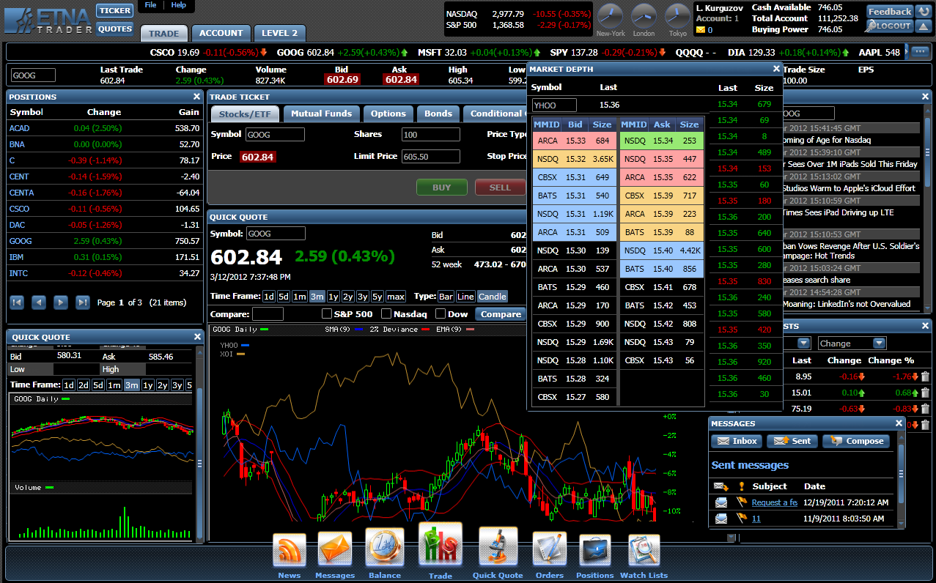

Slide 7
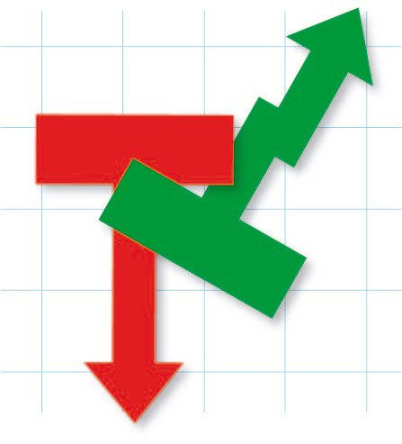

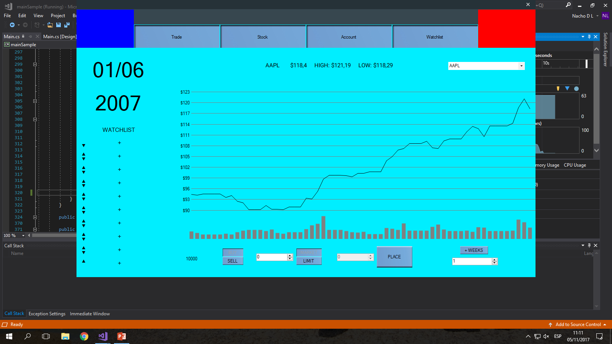



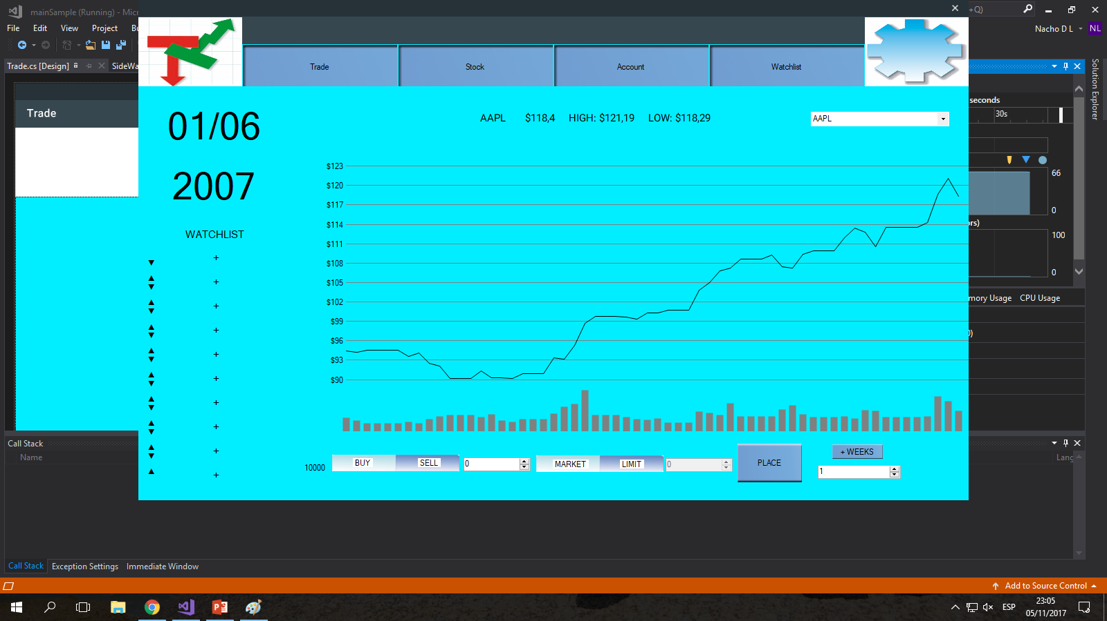
Trade
AAPL

Slide 8
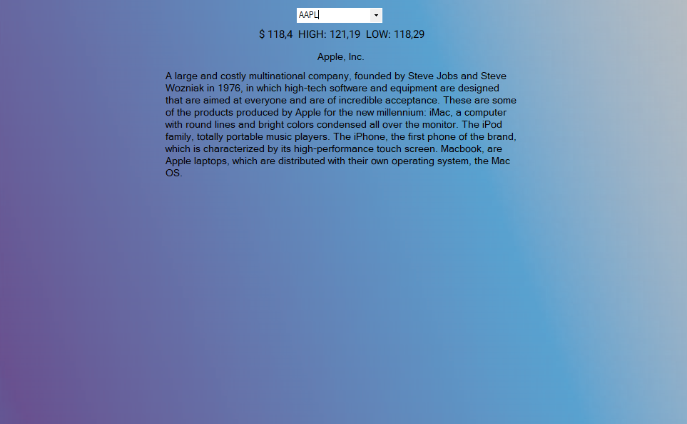
Stock
AAPL

Slide 9
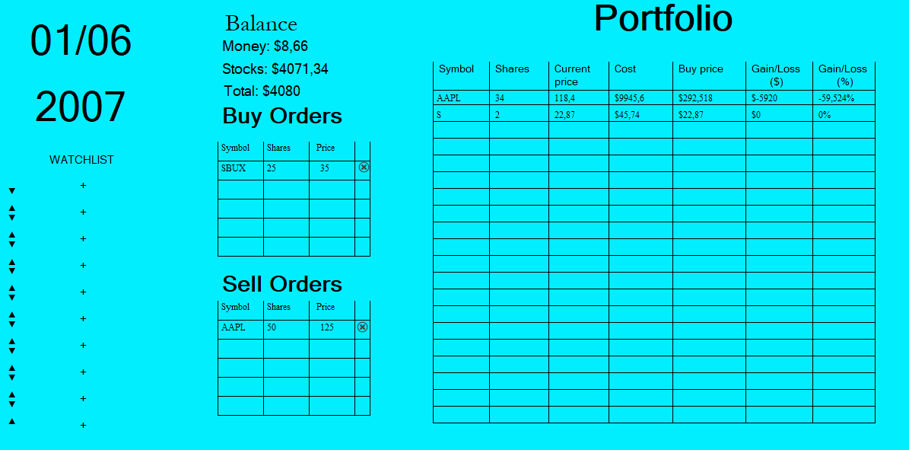
Account

Slide 10
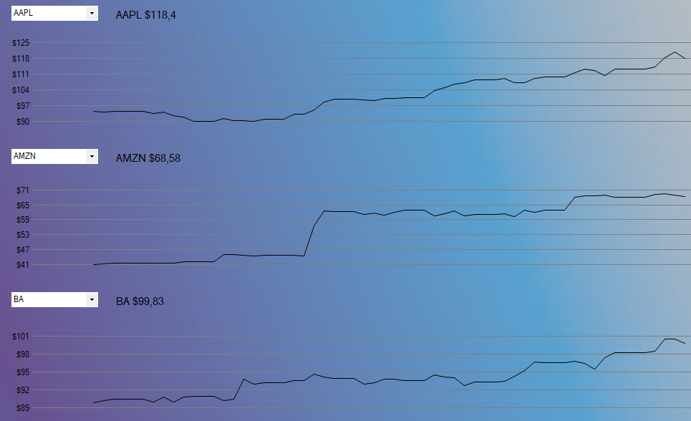
Watchlist
AAPL
AMZN
BA

Slide 11



Adobe Illustrator:
Search
Gear
Arrows

Slide 12



Adobe Illustrator:
Button to switch between operations
For reading text
For introducing text

Slide 13
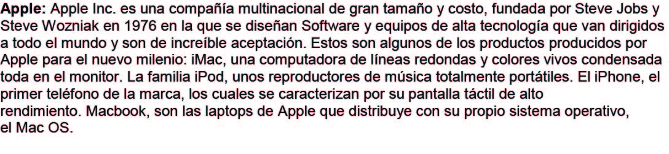

Adobe Illustrator:
Information for each company
Charming background

Slide 14
Adobe Illustrator:
Logo

Slide 15
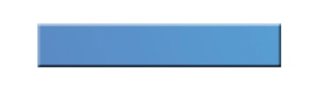

Adobe Photoshop:
Normal button
Pushed button

Slide 16

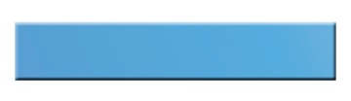





Slide 17
How does this +3000 lines of code project works?

Slide 18




Making the Database
It was necessary to get historical quotes data from the 2007-2009 time period, for all 20 companies included.
In order to obtain accurate data, several specialized websites were used as sources.

Slide 19
Organization
Aiming for a simple database, seven columns were created.
This was done taking into account the later inclusion of the data in the coding platform as well as the essential easy accessibility and understanding of the information.

Slide 20
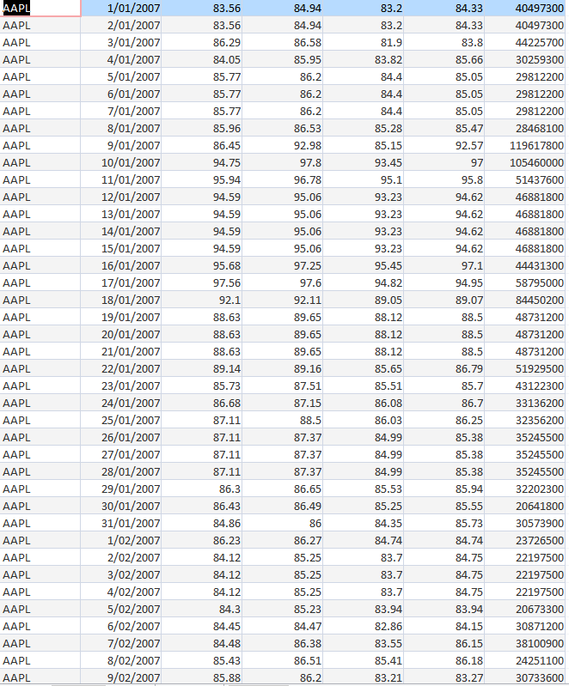
Extent and length
Including three years worth of information for twenty businesses, it comes as no surprise that the database is quite extense.
Surpassing the 20000 mark, the records have been verified, in order to ensure their vadility.

Slide 21
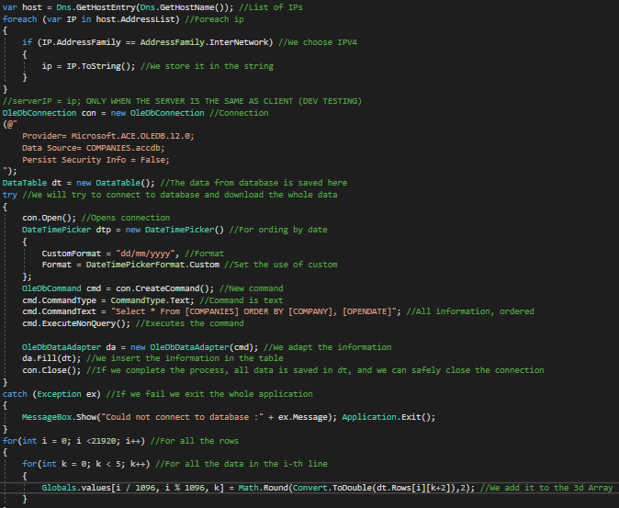
Loading additional data (Companies values)
In this process:
We get our own IP
We get the values for all days of all companies through and SQL select query, and we insert them into a 3D array

Slide 22
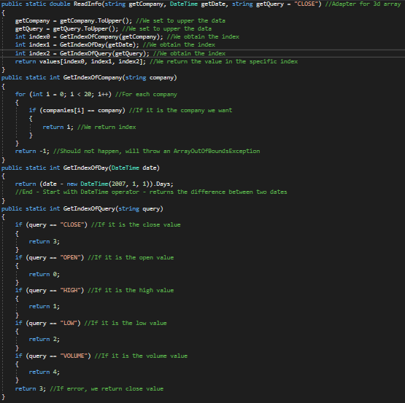
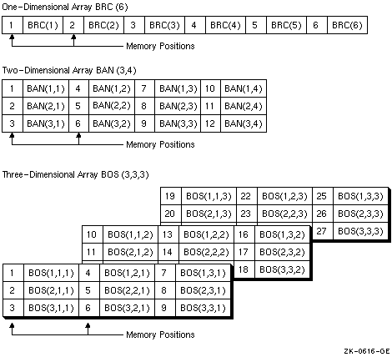
3D Arrays explained

Slide 23
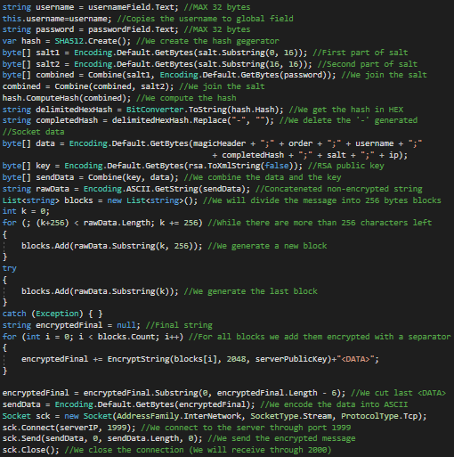
Login / Register
Data includes:
Client RSA public key
Header
Login/Register command
Username
Hash and Salt -when registering- (Salt is requested to the server in a similar connection)
IP (client)

Slide 24
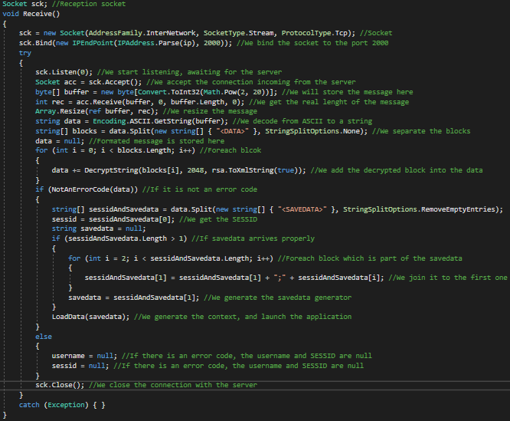
Reception
Client receives:
The savedata (context generating instructions) and SESSID
or
An error code

Slide 25
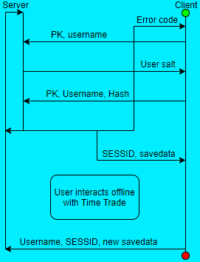
Connections

Slide 26
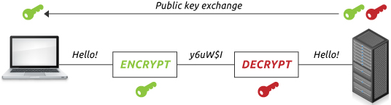
Security: RSA-2048 encrypted communications; salted SHA2-512 password storage
SHA2-512(XXXXXXXXXXXXXXXXUSERNAMEPASSWORDXXXXXXXXXXXXXXXX) =
7115F5A03959D66F35BF322E76C25075CAB1A45AFDB900CC2E74590AE5965FCDFA957DA31D307427833AFCB14FDB4FFFA0D4200EA7BBD0B0DF254A9B0B0E286E

Slide 27
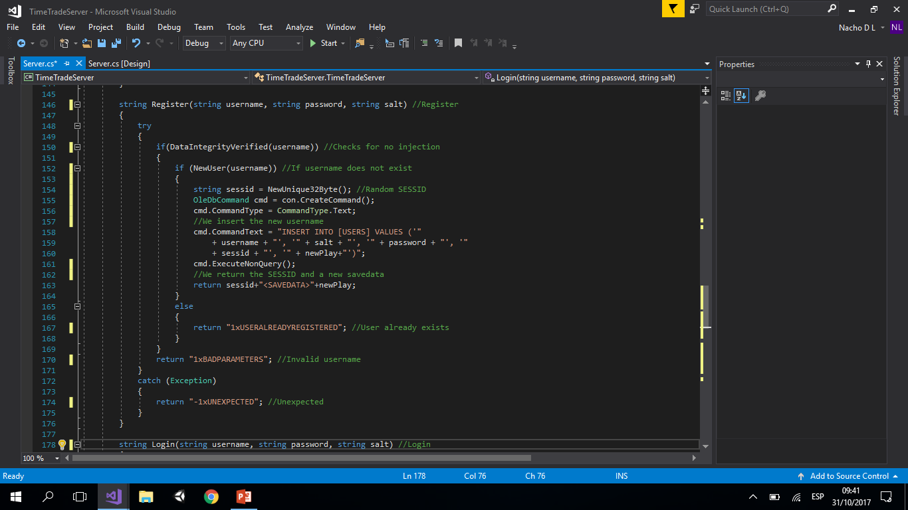
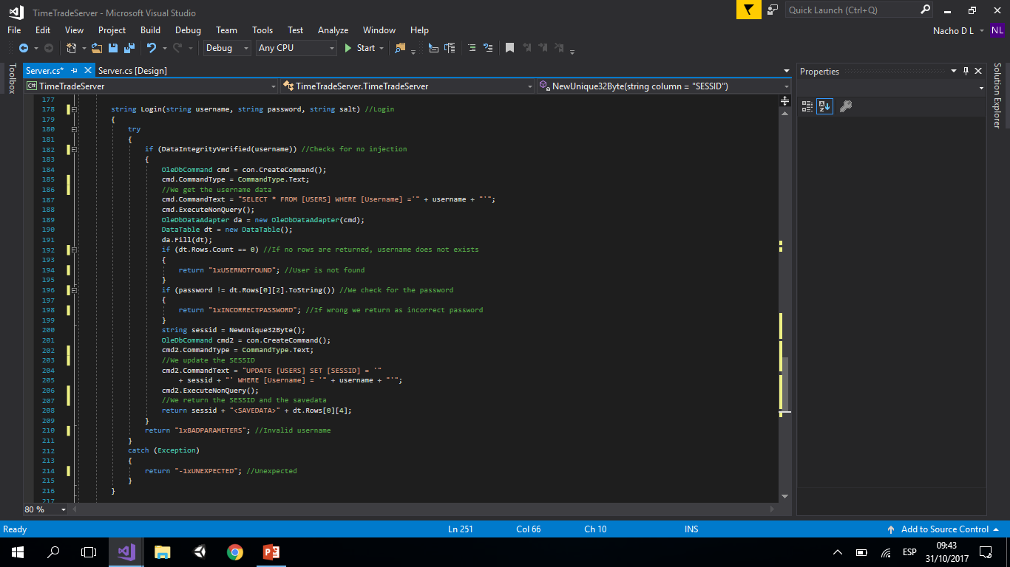
Server Register/Login

Slide 28
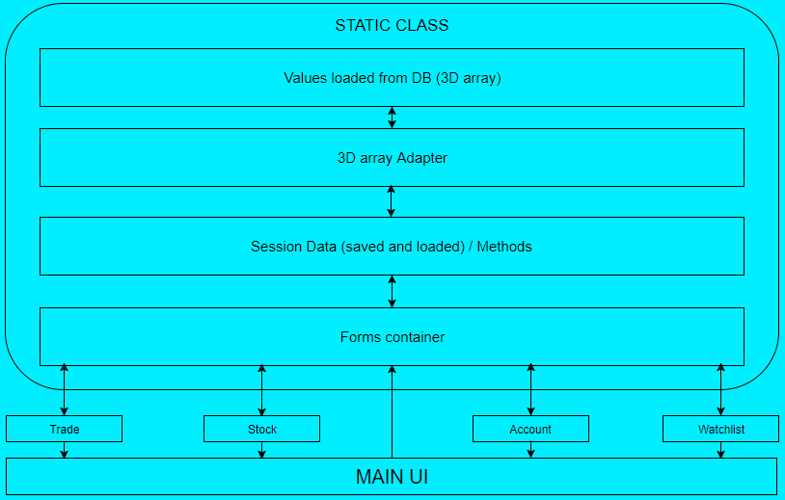
Time Trade operational context

Slide 29
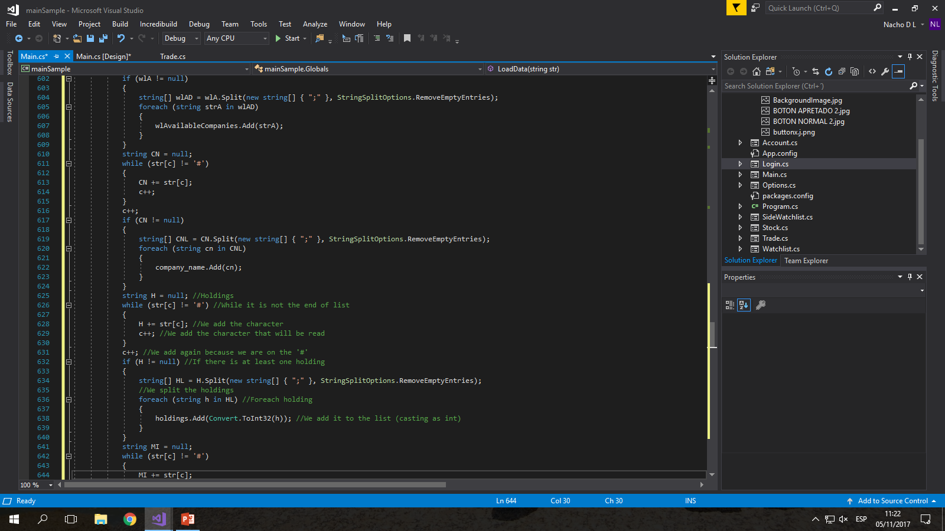
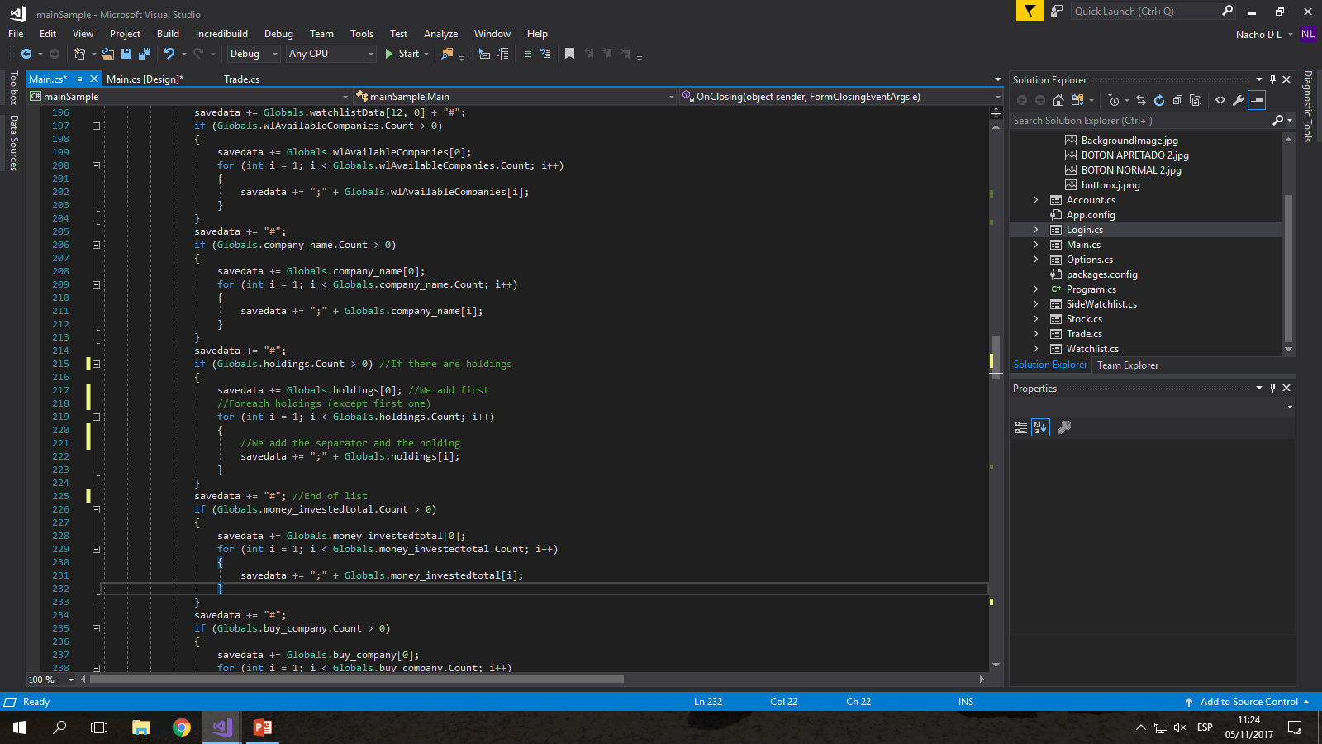
Session data adaption
AAPL;436,2;8;6;2007# SEEING COMPANY / MONEY / CURRENT DATE
AMZN;CAT;SBUX;Empty;Empty;Empty;Empty;Empty;Empty;Empty;AAPL;AMZN;BA# WATCHLIST
AAPL;BA;BBI;BBY;BP;C;DDAIF;F;INTC;JPM;KO;LEHMQ;MOT;MTLQQ.PK;S;T;TRMP# NON-WATCHLIST
AAPL;MOT# BOUGHT (PORTFOLIO)
30;5# AMOUNT (PORTFOLIO)
9472;91,8# INVESTED MONEY (PORTFOLIO)
MOT# BUY ORDER SYMBOLS LOADING
10# BUY AMOUNT (BUY ORDERS)
18# BUY PRICE (BUY ORDERS)
AAPL# SELL ORDER SYMBOLS
50# AMOUNT (SELL ORDERS)
125# SELL PRICE (SELL ORDERS)
9472# INVESTED IN (SELL ORDERS)
01/06/2007# DATE OF ORDER (BUY ORDERS) SAVING
01/06/2007# DATE OF ORDER (SELL ORDERS)

Slide 30
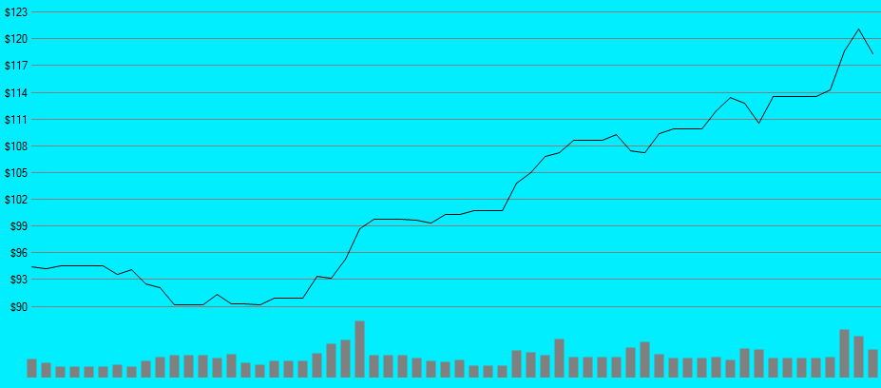
Graphics
Price references
Value displayed
Volume reference

Slide 31
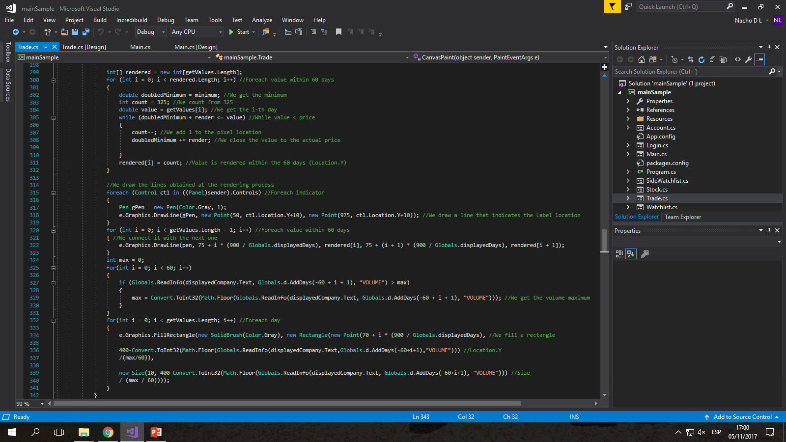
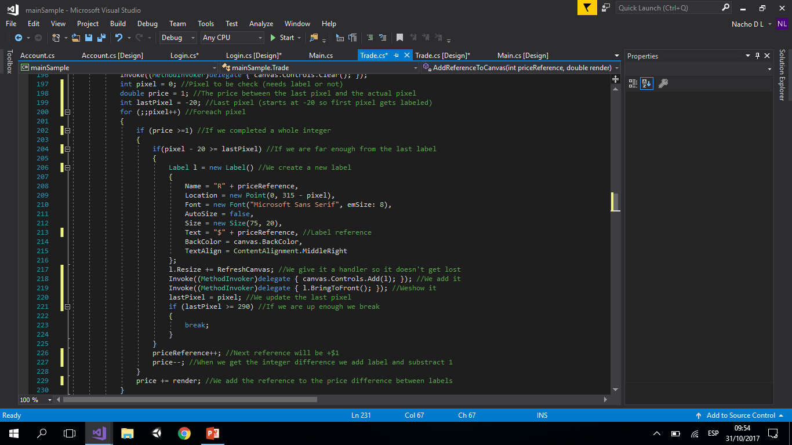
Graphics
We draw the lines joining the days
We draw the volume references
We add the price references

Slide 32
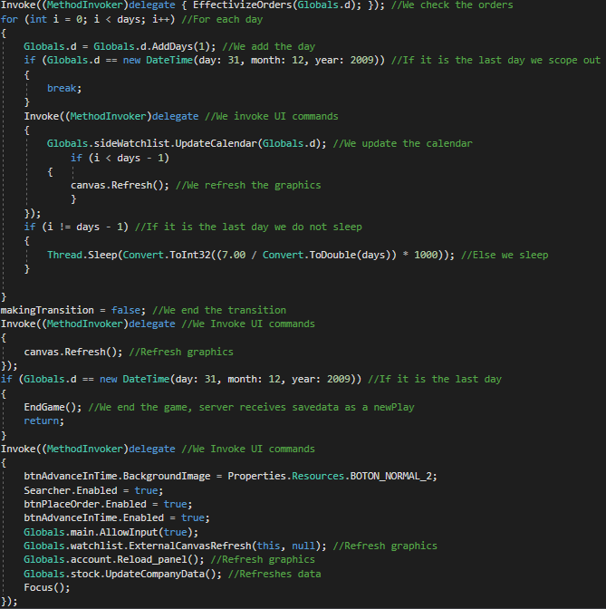
Transition

Slide 33
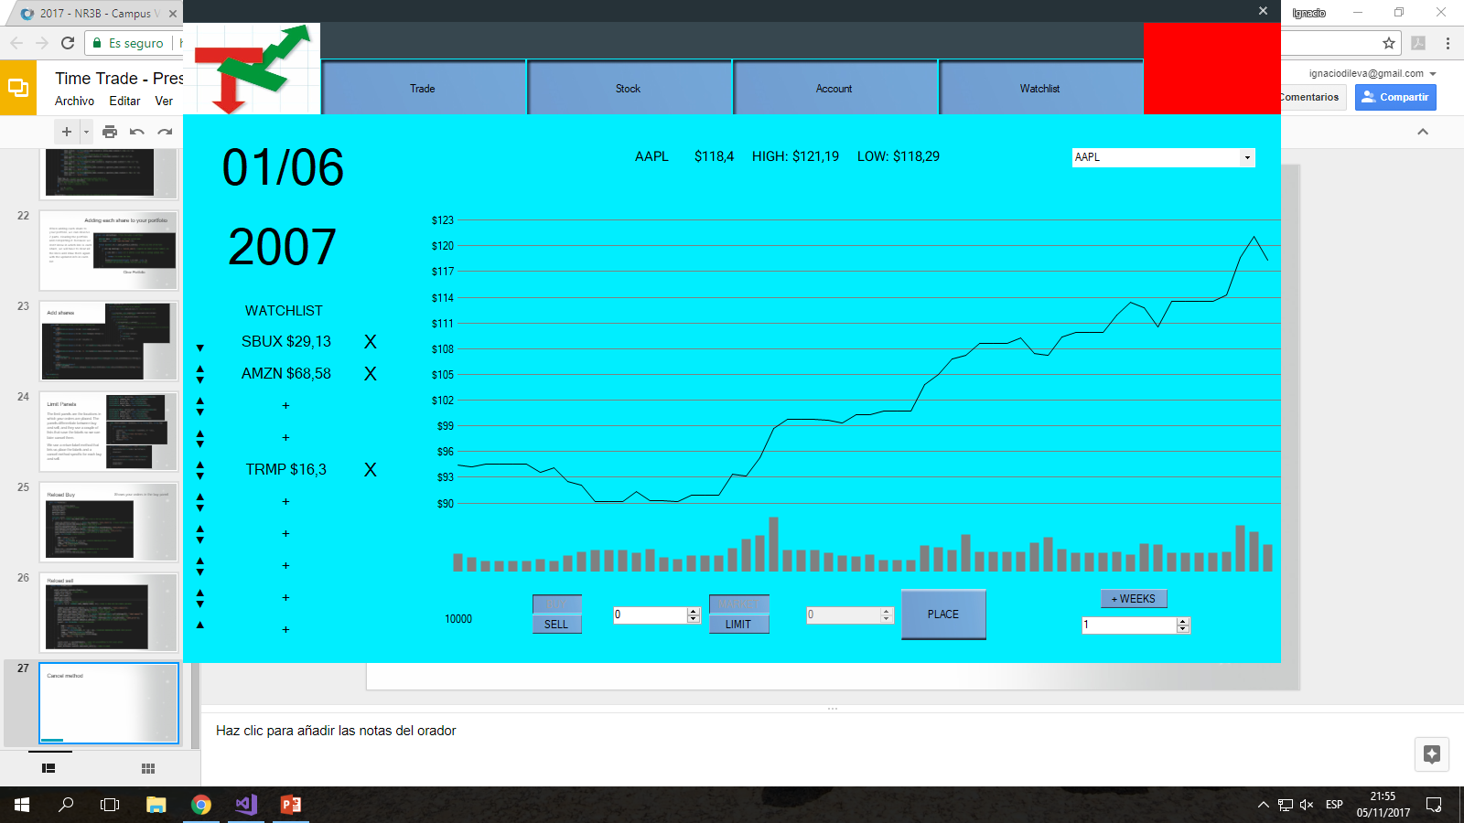
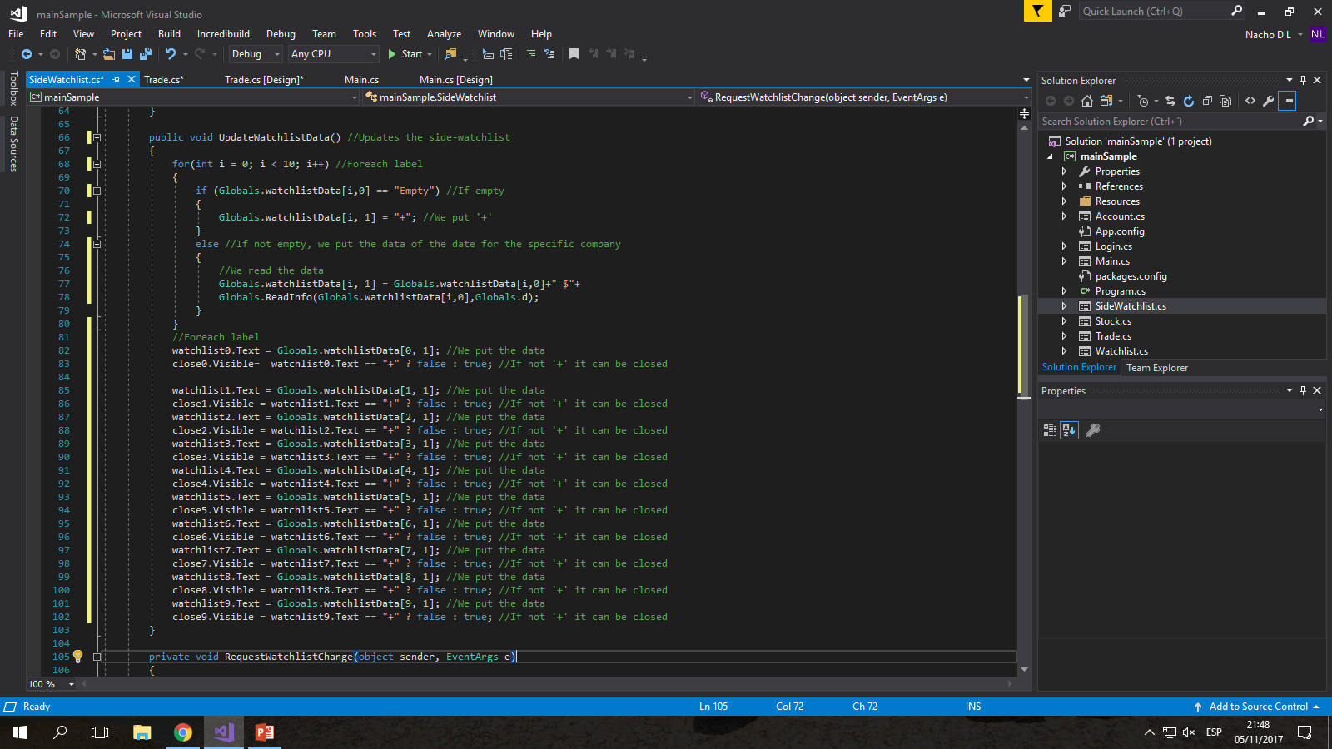
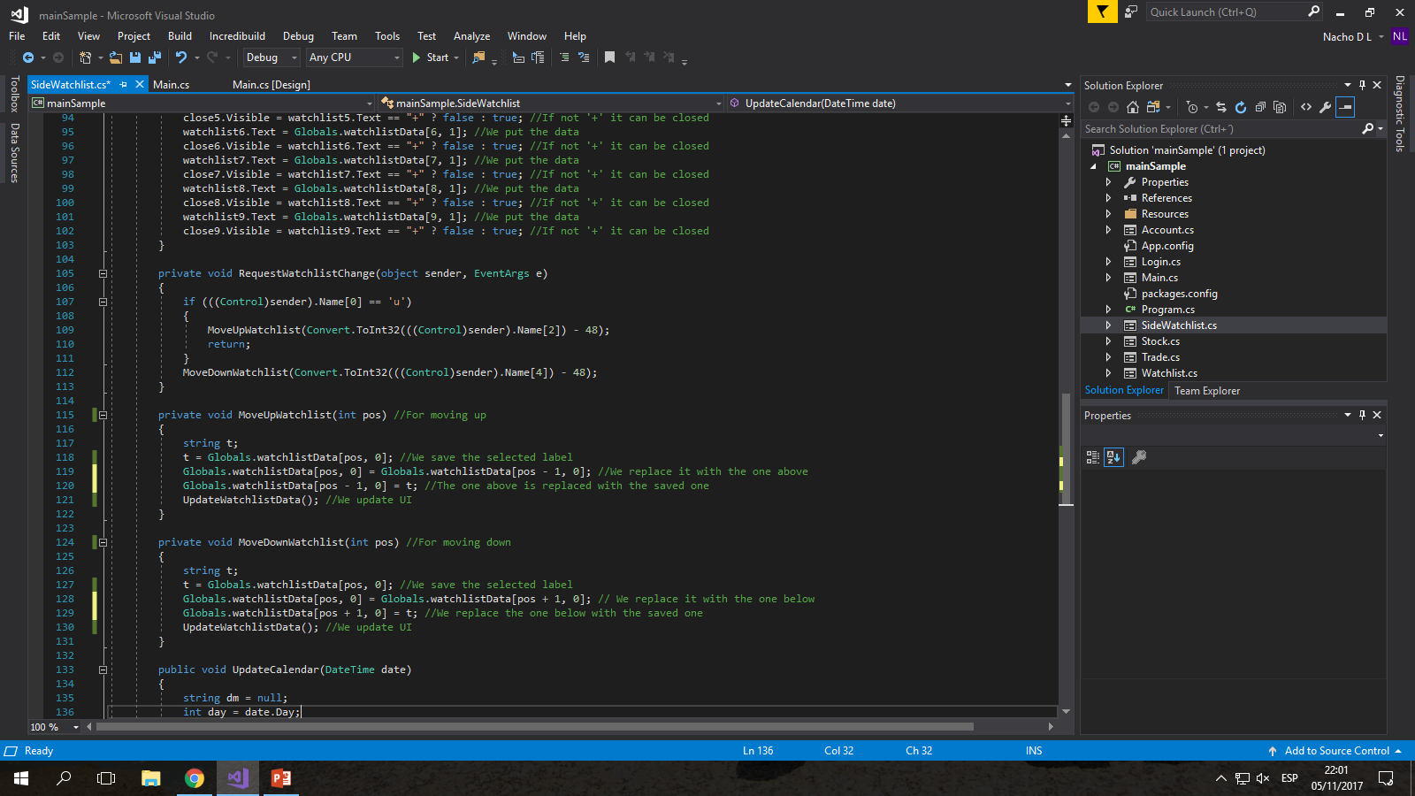
Side Watchlist

Slide 34
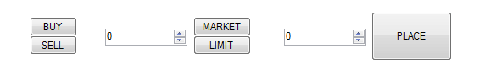
Buying and Selling
In the first NumericUpDown, you set the amount of shares you want to buy.
The second one is only enabled if you select the LIMIT option, which designates the price at which you want to place the orders.
Buying and selling have two options, buy directly or set orders that buy you automatically when the price of the stock reaches a certain value.
These orders are temporary and expire after 4 weeks.

Slide 35
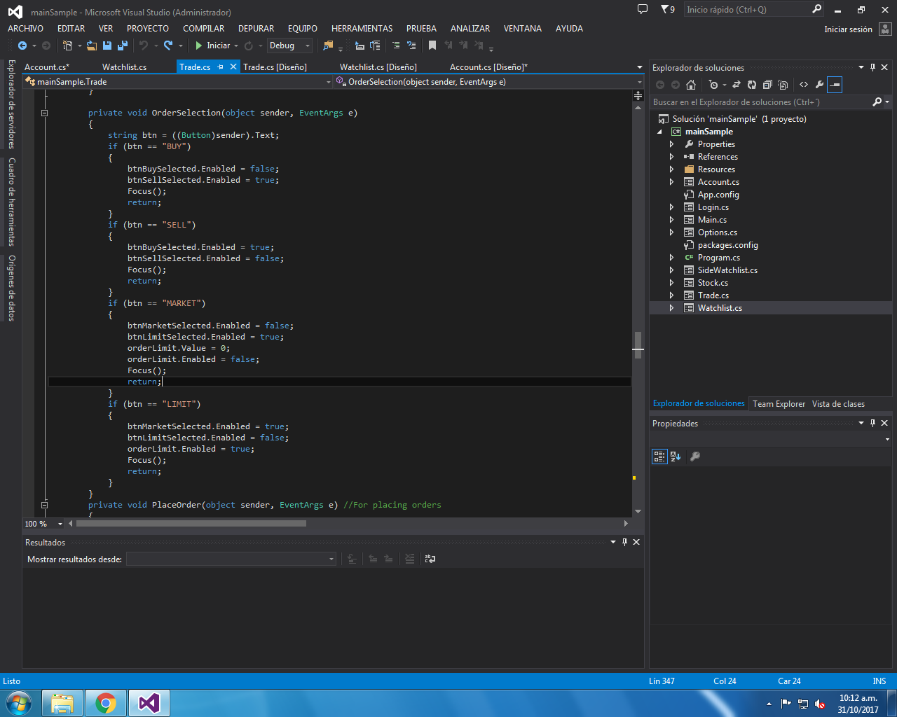

Slide 36
PlaceOrder
It is the function attached to the place button, which performs the transaction.
It is set in the Enabled feature of the buttons (Enabled == false means that it is the selection), in the values ​​of the NumericUpDown and the name and value of the company.
Place orders changes list values ​​present in the code.

Slide 37
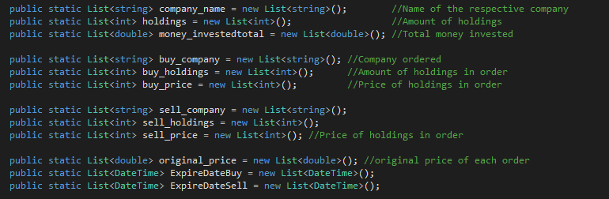
Lists

Slide 38
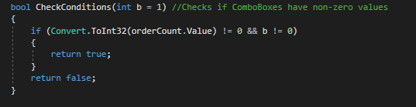
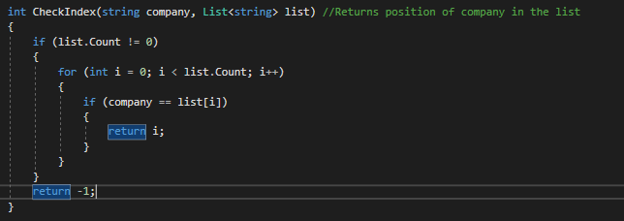
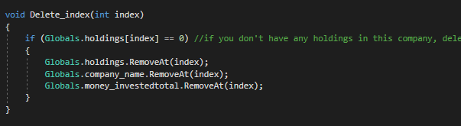
Placing
It is separated into 4 parts, Market Buy, Market Sell, Limit Buy, Limit Sell.
In addition, functions are used that fix the company's index in the lists, which the company deletes when it does not have shares and that ensure that the Numeric Boxes have values. These are called CheckIndex, DeleteIndex and CheckConditions.

Slide 39
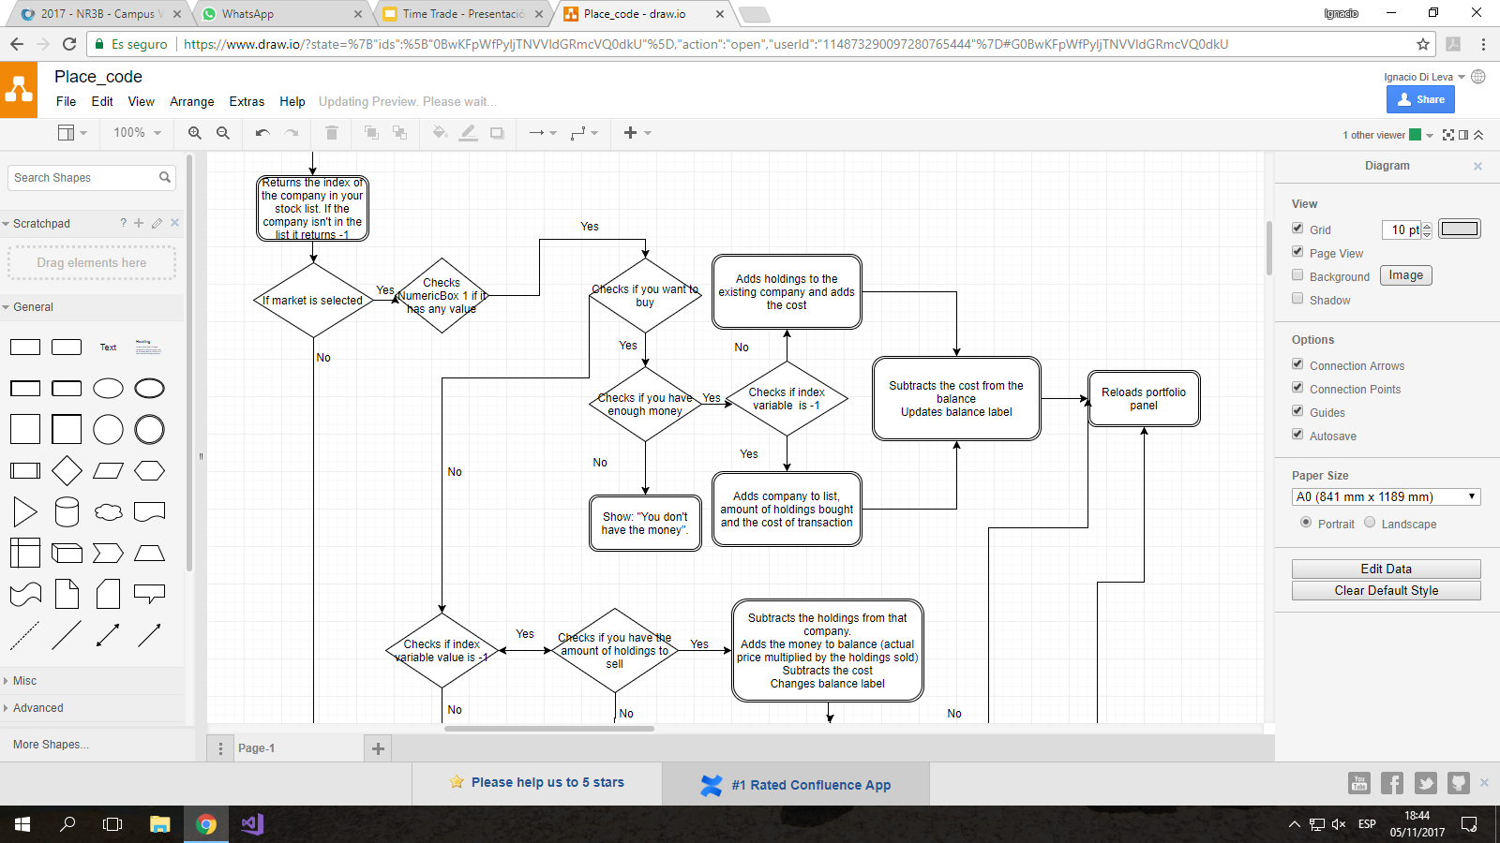
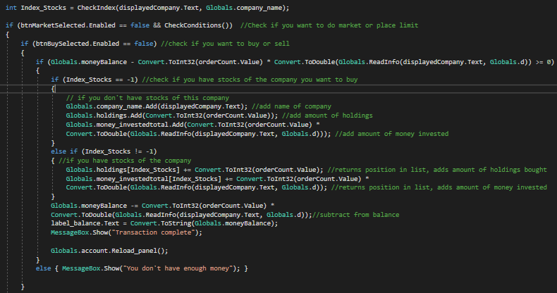
Buying (MARKET)

Slide 40
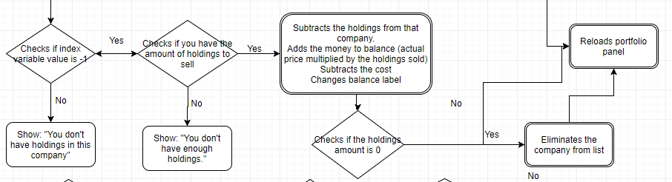
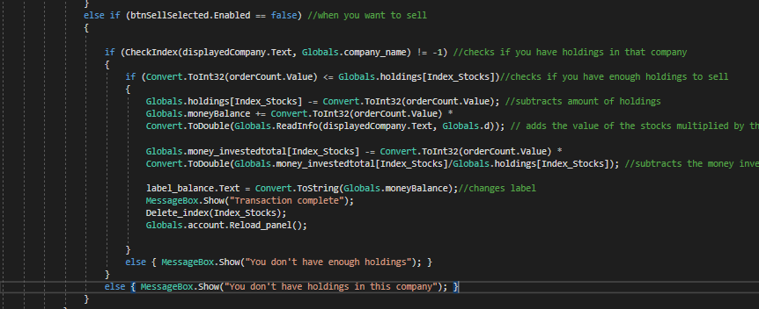
Selling (MARKET)

Slide 41
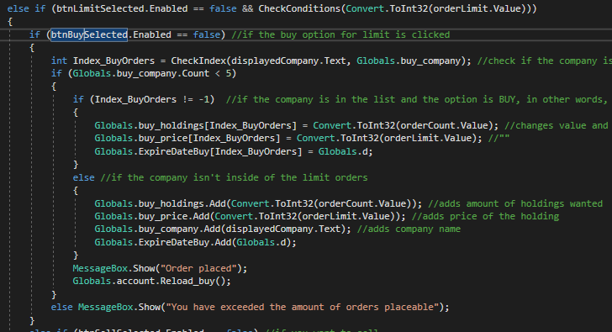
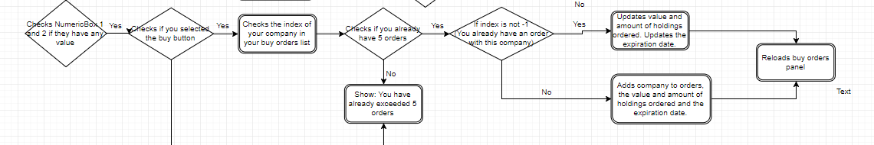
Limit Buy

Slide 42
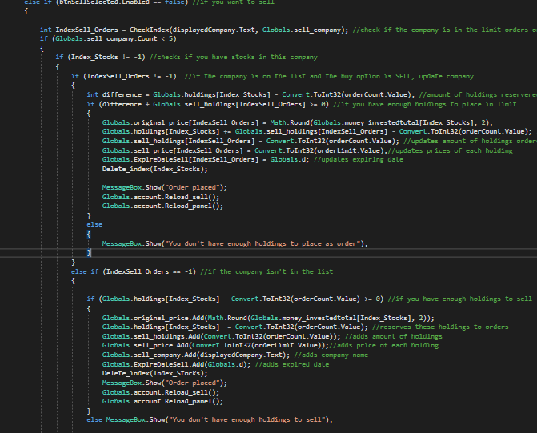
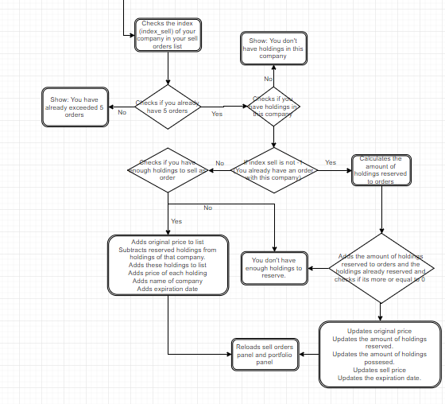
Limit Sell

Slide 43
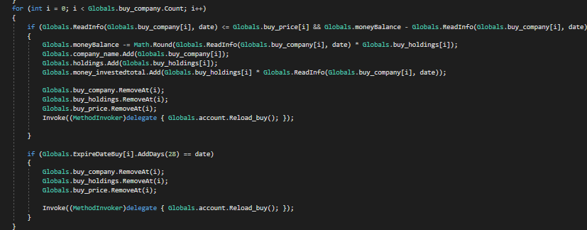
EffectivizeOrders
Buy Orders
It's the method that makes the automatic transaction of each order you make.
Splits between Buy Orders and Sell Orders

Slide 44
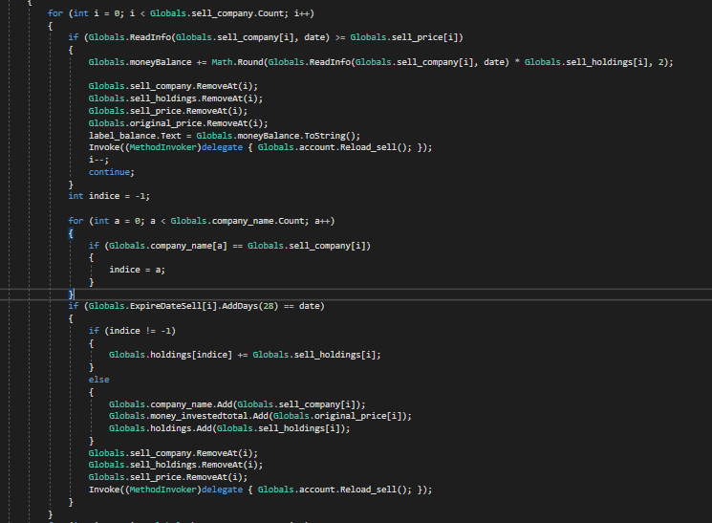
Sell Orders

Slide 45
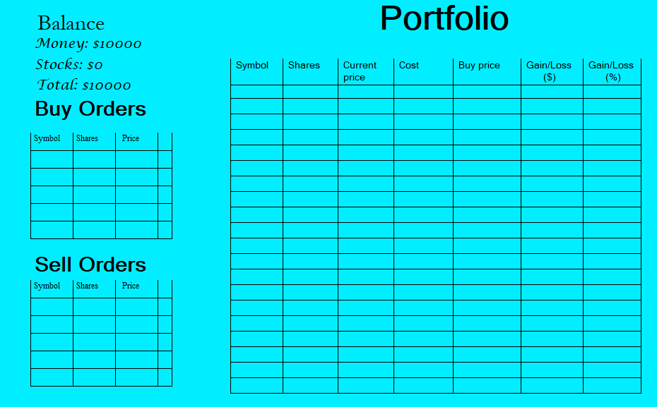
Portfolio
Your portfolio is where the stocks and orders are displayed.
It contains information such as gain loss, the price of each stocks, etc, and it is where you can cancel the orders you placed previously.

Slide 46
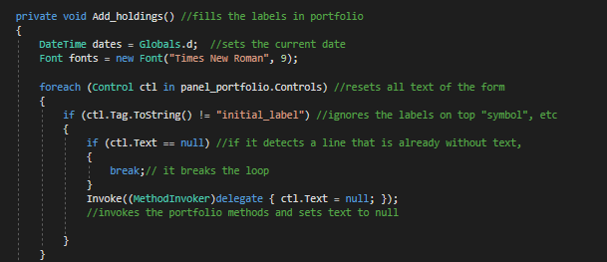
Adding each share
When adding each share to your portfolio, we can observe 2 parts, clearing the portfolio and completing it. Because we don’t know in which line is each share, we will have to clear all the lines and draw them again with the updated info in each list.
Clear Portfolio

Slide 47
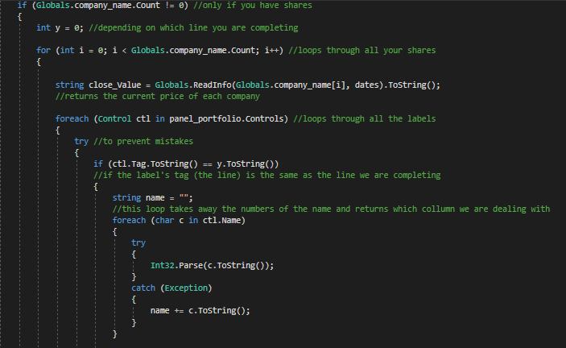

Add shares

Slide 48



Limit Panels
The limit panels are the locations in which your orders are placed. The panels differentiate between buy and sell, and they use a couple of lists that save the labels so we can later cancel them.
We use a return label method that lets us place the labels and a cancel method specific for each buy and sell.

Slide 49

Reload Buy
Shows your orders in the buy panel

Slide 50

Reload sell

Slide 51


Cancel method
Method added to the Cancel picturebox
Different between buy and sell orders.

Slide 52

Cancel sell
Because we reserve some shares as an order, when we cancel it they have to go back to the portfolio

